Slide 1
The.What.You.Need. App
By Team 6 - Kevin, Joel, Jason, Roberto.

Slide 2
The What You Need App is an application which essentially enables the user to create a list of things the user has or items the user needs. Furthermore, it gives the user the ability to search for the items needed from the closest store nearby or through websites.

Slide 3
Team Members Responsibilities and Contributions….

Slide 4
Joel Rosas
Joel worked on the Main and List Activities and classes of the project, he also worked on the database which stored the values inputted by the user. Joel is also going to be presenting for Team 6.

Slide 5
Kevin Acquaah
Kevin worked on the List and Need Activities and classes of the project. He was also in charge of creating the Google Slides Presentation for Team 6.

Slide 6
Jason Cedillo
Jason worked on the settings aspect of the project, which essentially changes the backgrounds of each list created.

Slide 7
Roberto Morales
Roberto worked on the Got activity and class of the project.

Slide 8
Challenges….

Slide 9
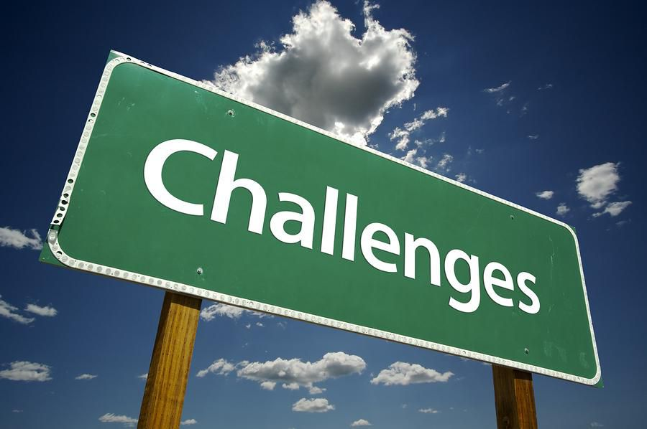
Challenges Encountered
It was challenging working as a group from home, since we all have different schedules and duties.
Another challenge was figuring out how to use Databases and understanding how they worked.
Retrieving data and information from the preferences was also another challenge that had to be dealt with.

Slide 10
In Continuation...

Slide 11
Lessons Learned….

Slide 12
The Lessons Learned are:
In order to work effectively as a group, time always has to be utilized efficiently.
We learned how to implement the Database, as well as how to display it on the screen.
Another lesson learned overall, is how to make stable and efficient Android Apps.
Communication is always taken for granted, however it is extremely important. There is a lot of importance in communication, and we learned that as a team.

Slide 13
Accomplishments….

Slide 14
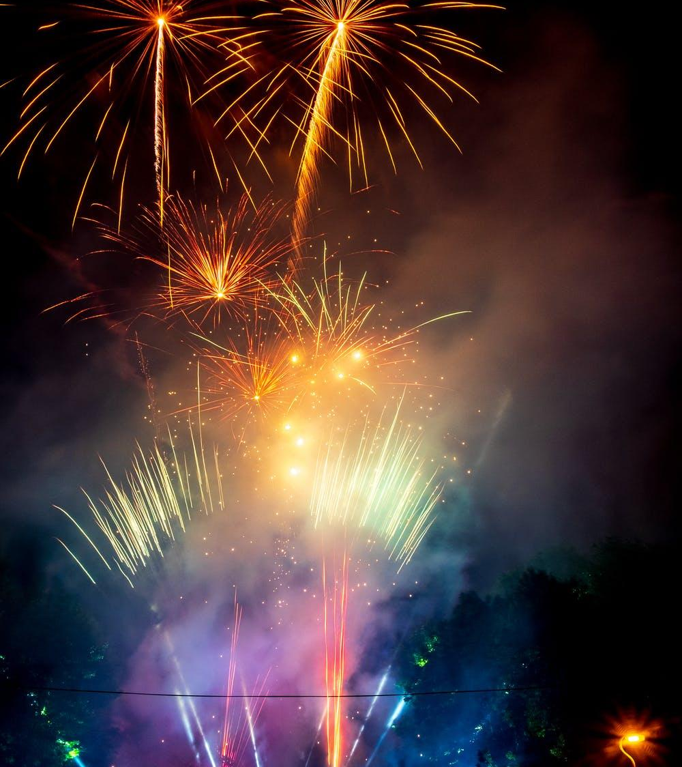
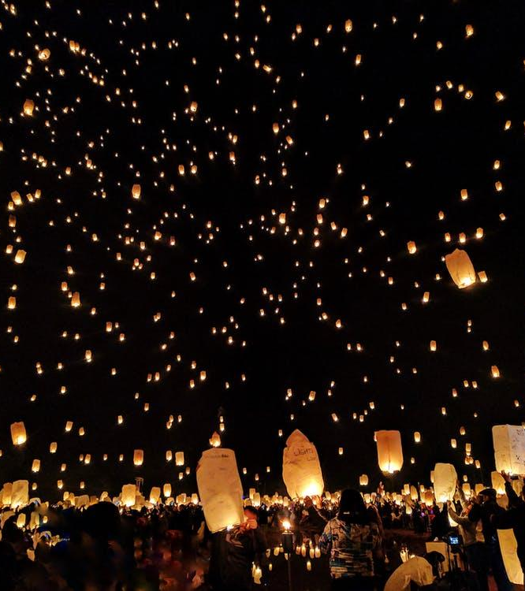
Always Celebrate EVERY Accomplishment big or small !

Slide 15
Accomplishments
We are proud of coming together as a group and being able to complete this project, it was a lot of hard work but at the end of the day we saw it through and completed it in time.

